Slide 1
Organizational Control and Change
chapter VI
McGraw-Hill/Irwin
Contemporary Management, 5/e
Copyright © 2008 The McGraw-Hill Companies, Inc. All rights reserved.

Slide 2
Learning Objectives
Define organizational control, and describe the four steps of the control process.
Identify the main output controls, and discuss their advantages and disadvantages as means of coordinating and motivating employees.
Identify the main behavior controls, and discuss their advantages and disadvantages as means of coordinating and motivating employees.
Discuss the relationship between organizational control and change, and explain why managing change is a vital management task
11-<number>

Slide 3

Organizational Control
Organizational Control
  Managers monitor and regulate how efficiently and effectively an organization and its members are performing the activities necessary to achieve organizational goals
11-<number>
Notes:
Keeping an organization on track, anticipating events, changing the organization to respond to opportunities and threats

Slide 4
Organizational Control
Managers must monitor and evaluate:
  Is the firm efficiently converting inputs into outputs?
    Are units of inputs and outputs measured accurately?
  Is product quality improving?
    Is the firm’s quality competitive with other firms?
  Are employees responsive to customers?
    Are customers satisfied with the services offered?
  Are our managers innovative in outlook?
    Does the control system encourage risk-taking?
11-<number>

Slide 5
Control Systems
  Formal, target-setting, monitoring, evaluation and feedback systems that provide managers with information about whether the organization’s strategy and structure are working efficiently and effectively.
A good control system should:
  be flexible so managers can respond as needed.
  provide accurate information about the organization.
  provide information in a timely manner.
11-<number>

Slide 6
Discussion Question?
Which is the most important type of control?
Feedforward
Feedback
Concurrent
Accounting
11-<number>
Notes:
There is no one best answer. Students should discuss situations appropriate for using each control type.

Slide 7
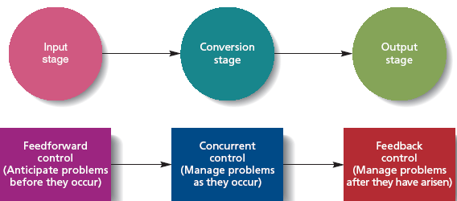
Three Types of Control
Figure 11.1
11-<number>

Slide 8
Types of Control
Feedforward Controls
  Used to anticipate problems before they arise so that problems do not occur later during the conversion process
  Giving stringent product specifications to suppliers in advance
  IT can be used to keep in contact with suppliers and to monitor their progress
11-<number>

Slide 9
Types of Control
Concurrent Controls
  Give managers immediate feedback on how efficiently inputs are being transformed into outputs
    Allows managers to correct problems as they arise
Feedback Controls
  Used to provide information at the output stage about customers’ reactions to goods and services so that corrective action can be taken if necessary
11-<number>

Slide 10
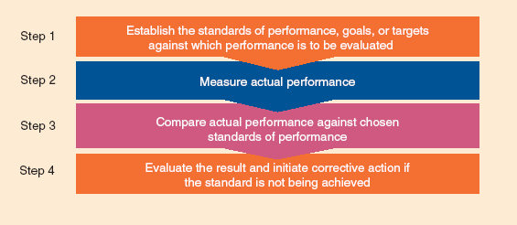
Control Process Steps
Figure 11.2
11-<number>

Slide 11
The Control Process
Establish standards of performance, goals, or targets against which performance is to be evaluated.
  Managers at each organizational level need to set their own standards.
Measure actual performance
  Managers can measure outputs resulting from worker behavior or they can measure the behavior themselves.
    The more non-routine the task, the harder it is to measure behavior or outputs
11-<number>

Slide 12
The Control Process
Compare actual performance against chosen standards of performance
  Managers evaluate whether – and to what extent – performance deviates from the standards of
  performance
  chosen in step 1
Evaluate result and initiate corrective action if the standard is not being achieved
  If managers decide that the level of performance is unacceptable, they must try to change the way work activities are performed to solve the problem
11-<number>

Slide 13
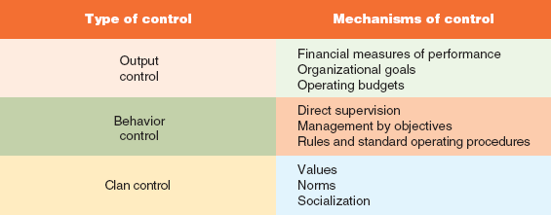
Three Organizational Control Systems
Figure 11.3
11-<number>

Slide 14
Question?
Which ratio measures how well managers have protected organizational resources to be able to meet short-term obligations?
Profit ratios
Leverage ratios
Liquidity ratios
Operating ratios
11-<number>
Notes:
The correct answer is “C” – liquidity ratios. See slide 11-23.

Slide 15
Financial Measures of Performance
Profit Ratios –
  measure how efficiently managers are using the organization’s resources to generate profits
Return on Investment (ROI) –
  most commonly used financial performance measure
  organization’s net income before taxes divided by its total assets
Operating margin
  calculated by dividing a companies operating profit by sales revenue
  Provides managers with information about how efficiently an organization is utilizing its resources
11-<number>

Slide 16
Financial Measures of Performance
Liquidity ratios
  measure how well managers have protected organizational resources to be able to meet short-term obligations
Leverage ratios
  measure the degree to which managers use debt or equity to finance ongoing operations
Activity ratios
  provide measures of how well managers are creating value from organizational assets
11-<number>

Slide 17
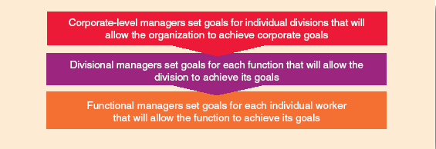
Organization-Wide Goal Setting
Figure 11.4
11-<number>

Slide 18
Output Control
Organizational Goals
  Each division within the firm is given specific goals that must be met in order to attain overall organizational goals.
    Goals should be set appropriately so that managers are motivated to accomplish them
Operating Budgets
  Blueprint that states how managers intend to use organizational resources to achieve organizational goals efficiently.
11-<number>

Slide 19
Effective Output Control
Objective financial measures
Challenging goals and performance standards
Appropriate operating budgets
11-<number>

Slide 20
Problems with Output Control
Managers must create output standards that motivate at all levels
Should not cause managers to behave in inappropriate ways to achieve organizational goals
11-<number>

Slide 21
Behavior Control
Direct supervision
  managers who actively monitor and observe the behavior of their subordinates
  Teach subordinates appropriate behaviors
  Intervene to take corrective action
  Most immediate and potent form of behavioral control
  Can be an effective way of motivating employees
11-<number>

Slide 22
Problems with Direct Supervision
Very expensive because a manager can personally manage only a relatively small number of subordinates effectively
Can demotivate subordinates if they feel that they are under such close scrutiny that they are not free to make their own decisions
11-<number>

Slide 23

Management by Objectives
Management by Objectives (MBO)
  formal system of evaluating subordinates for their ability to achieve specific organizational goals or performance standards and to
  meet operating
  budgets
11-<number>

Slide 24
Management by Objectives
Specific goals and objectives are established at each level of the organization
Managers and their subordinates together determine the subordinates’ goals
Managers and their subordinates periodically review the subordinates’ progress toward meeting goals
11-<number>

Slide 25
Question?
Which type of control is exerted on individuals in an organization by shared values, norms, standards of behavior, and expectations?
Bureaucratic control
Clan control
Revolutionary control
Evolutionary control
11-<number>
Notes:
The correct answer is “B” – clan control. See slide 11-37.

Slide 26
Bureaucratic Control
Bureaucratic Control
  Control through a system of rules and standard operating procedures (SOPs) that shapes and regulates the behavior of divisions, functions, and individuals.
Problems with Bureaucratic Control
  Rules easier to make than than discarding them, leading to bureaucratic “red tape” and slowing organizational reaction times to problems.
  Firms become too standardized and lose flexibility to learn, to create new ideas, and solve to new problems.
11-<number>

Slide 27

Clan Control
Clan Control
  The control exerted on individuals and groups in an organization by shared values, norms, standards of behavior, and expectations.
11-<number>

Slide 28
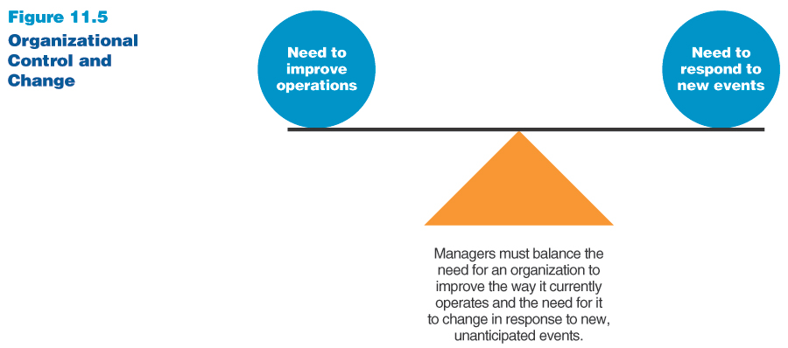
Organizational Change
Movement of an organization away from its present state and toward some desired future state to increase its efficiency and effectiveness
11-<number>

Slide 29
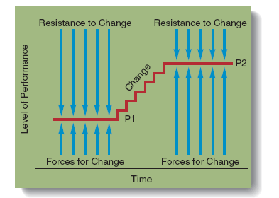
Lewin’s Force-Field Theory of Change
Figure 11.6
11-<number>

Slide 30
Lewin’s Force-Field Theory of Change
There are a wide variety of forces arising from the way an organization operates, from its structure, culture, and control systems that make organizations resistant to change
To get an organization to change, managers must find a way to increase the forces for change, reduce resistance to change, or do both simultaneously
11-<number>

Slide 31
Evolutionary and Revolutionary Change
Evolutionary change
  gradual, incremental, and narrowly focused
  constant attempt to improve, adapt, and adjust strategy and structure incrementally to accommodate changes in the environment
Revolutionary change
  Rapid, dramatic, and broadly focused
  Involves a bold attempt to quickly find ways to be effective
  Likely to result in a radical shift in ways of doing things, new goals, and a new structure for the organization
11-<number>

Slide 32
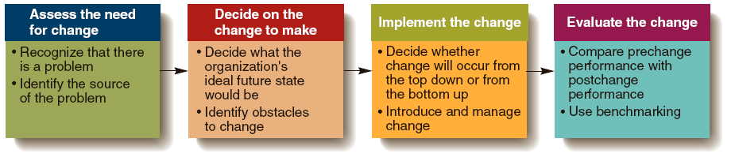
Steps in the Organizational Change Process
Figure 11.7
11-<number>

Slide 33
Implementing the Change
Top Down Change
  A fast, revolutionary approach to change in which top managers identify what needs to be changed and then move quickly to implement the changes throughout the organization.
Bottom-up change
  A gradual or evolutionary approach to change in which managers at all levels work together to develop a detailed plan for change.
11-<number>

Slide 34

Evaluating the Change
Benchmarking
  The process of comparing one company’s performance on specific dimensions with the performance of other, high-performing organizations.
11-<number>

Slide 35
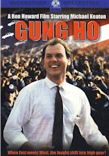
Movie Example: Gung Ho
How do the employees of Assan Motors react to changes from the new Japanese management?
11-<number>
Notes:
Organizational Control and Change
Gung Ho
Hunt Stevenson (Michael Keaton) wants to save his town. He flies to Japan and convinces a Japanese car company (the fictional Assan Motors) to reopen a closed factory in the town of Hadleyville, PA. Assan Motors reopens the plant and a clash of Japanese and American culture and values ensues. The Japanese managers introduce uniforms, morning exercises, production efficiency and quality control to the plant. The Americans teach the Japanese about the importance of family and loyalty to each other.
It is the first day for the new Assan Motors employees. The employees are happy to be working again. Hunt Stevenson (Michael Keaton) has accepted the job of liaison between the Japanese management and the American workers. The plant manager, Kazihiro (Gedde Watanabe) is beginning the day with exercises and a speech about company loyalty.
Could Kazihiro have done anything differently to improve the transition?
Are exercises and uniforms a necessary part of running a manufacturing facility?
Was Stevenson effective in leading the workers to change?

